Slide 1
Event Planning
Web-based Application
WebIt: Krishna Viradia, Courtney Burns, Sara Nazir, Wubnyonga Tete, Theresa Tomilson, Mehak Uddin, Nuri Ousman

Slide 2
Functional Requirements
Process-oriented
Authorized personnel can login
Users can view weekly schedules
Employees can view available dates
Employees can view event type when inputting customer order
Allows payment processing
Produces reports
Information-oriented
Retain customer information (2 years)
Include planned and accomplished per year
Produce monthly and yearly reports (sales)

Slide 3
Non-Functional Requirements
Operational
Any device can be used to operate on the system
Any web browser can be used to operate on the system
Performance
Rapid response times. (application loading, browser refresh times, etc. should not take more than 2 minutes.)
Feasibly system. No intensive training should be required to understand the system’s operations and functionalities.
Security
Password length should be 8 or more characters long and must include special character.
Passwords should never be viewable at the point of entry or at any other time.
Only the admin (owner) can create and edit invoices.
Employees are unable to update salary and schedule information. If this is violated the employees should be reported to the administrator.
Cultural and Political
Invoice payments in foreign and US currencies should be processed by the system.
The primary location of the company is in the DMV area.

Slide 4
Interview - Vicky Tawle (Our Client)
Name of interviewee: Vicky Tawle
Company: Vicky Event Planning
Name of Interviewer: Wubnyonga Tete
Date of Interview: 03/23/2019, Time: 1:00pm

Slide 5

Interview - Bobby Moges
Name of Interviewee: Bobby Moges
Position: Event Coordinator
Company: Van Scoyoc Associates Lobbying Firm
Name of interviewer: Nuri Surur
Date: 03/23/2019, Time: 11:45 am

Slide 6

Interview - Kalkidan Gizaw
Name of Interviewee: Kalkidan Gizaw
Position: Director of Finances and Business Events
Company: Women's Health Association
Name of interviewer: Nuri Surur
Date: 03/20/2019 , Time: 6:00 pm

Slide 7
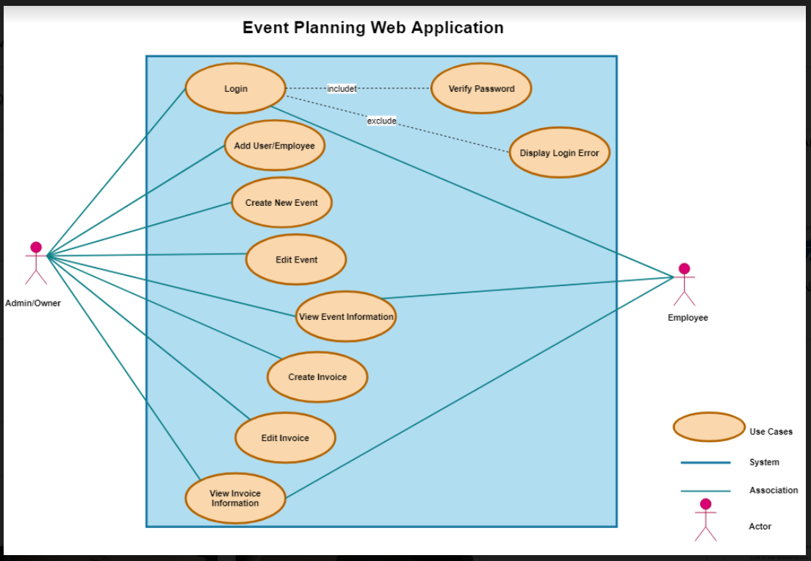
Use Case Diagram

Slide 8
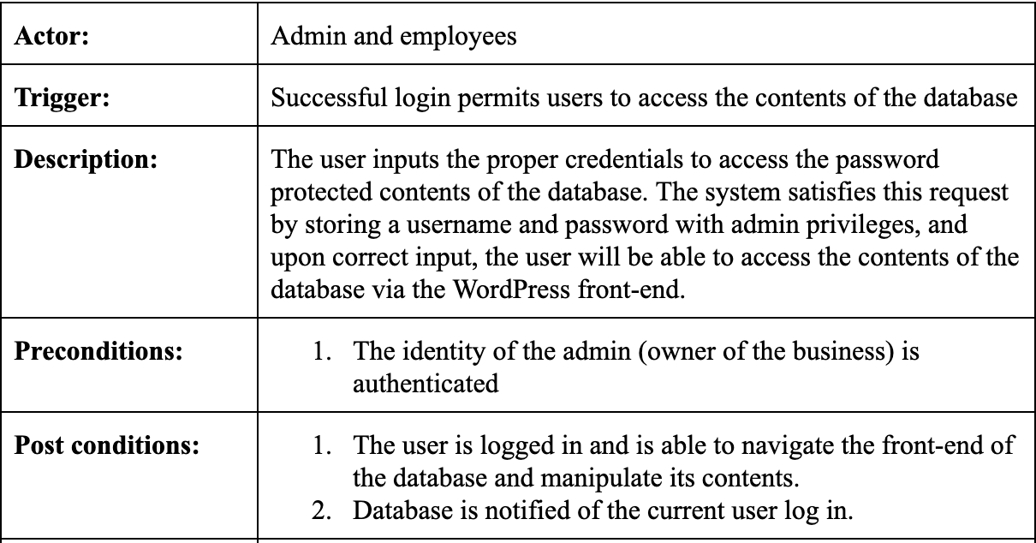
Use Case - Login

Slide 9
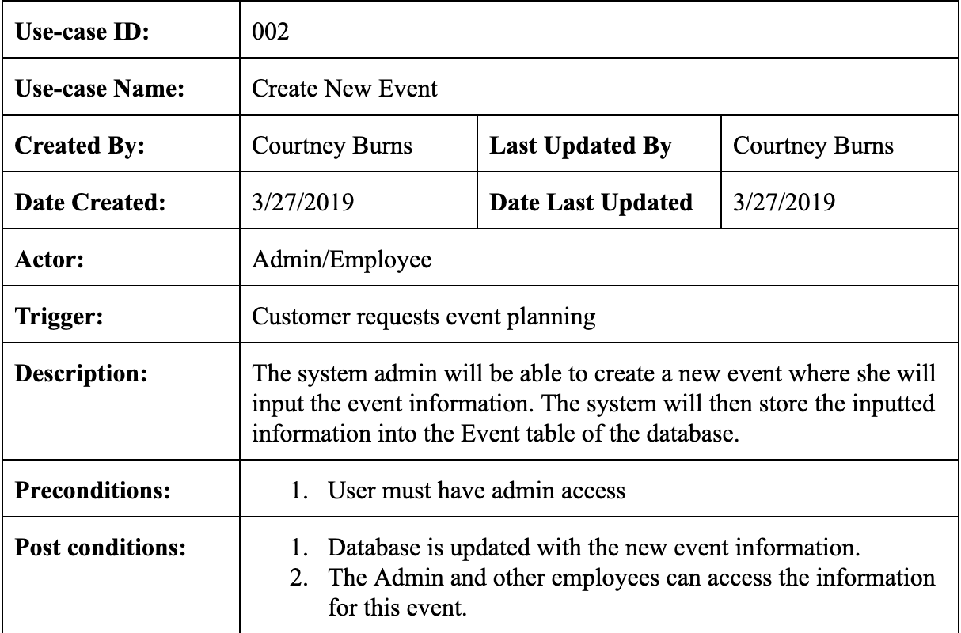
Use Case - Create New Event

Slide 10
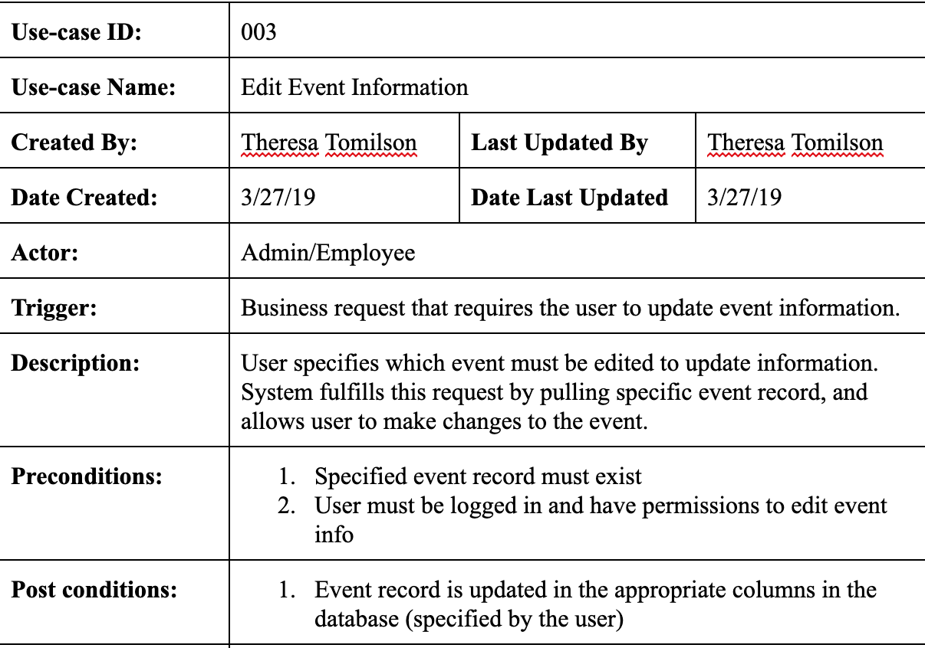
Use Case - Edit Event Information

Slide 11
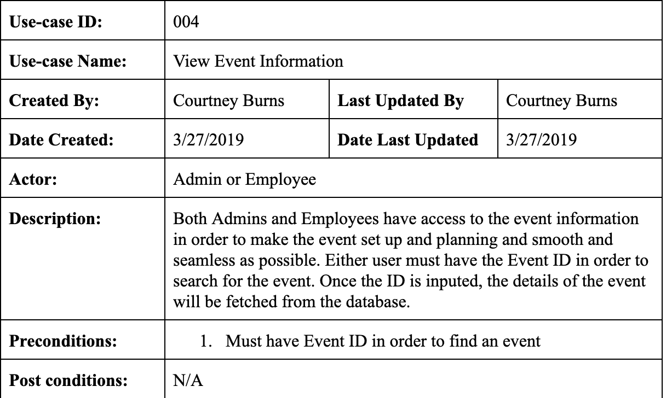
Use Case - View Event Information

Slide 12
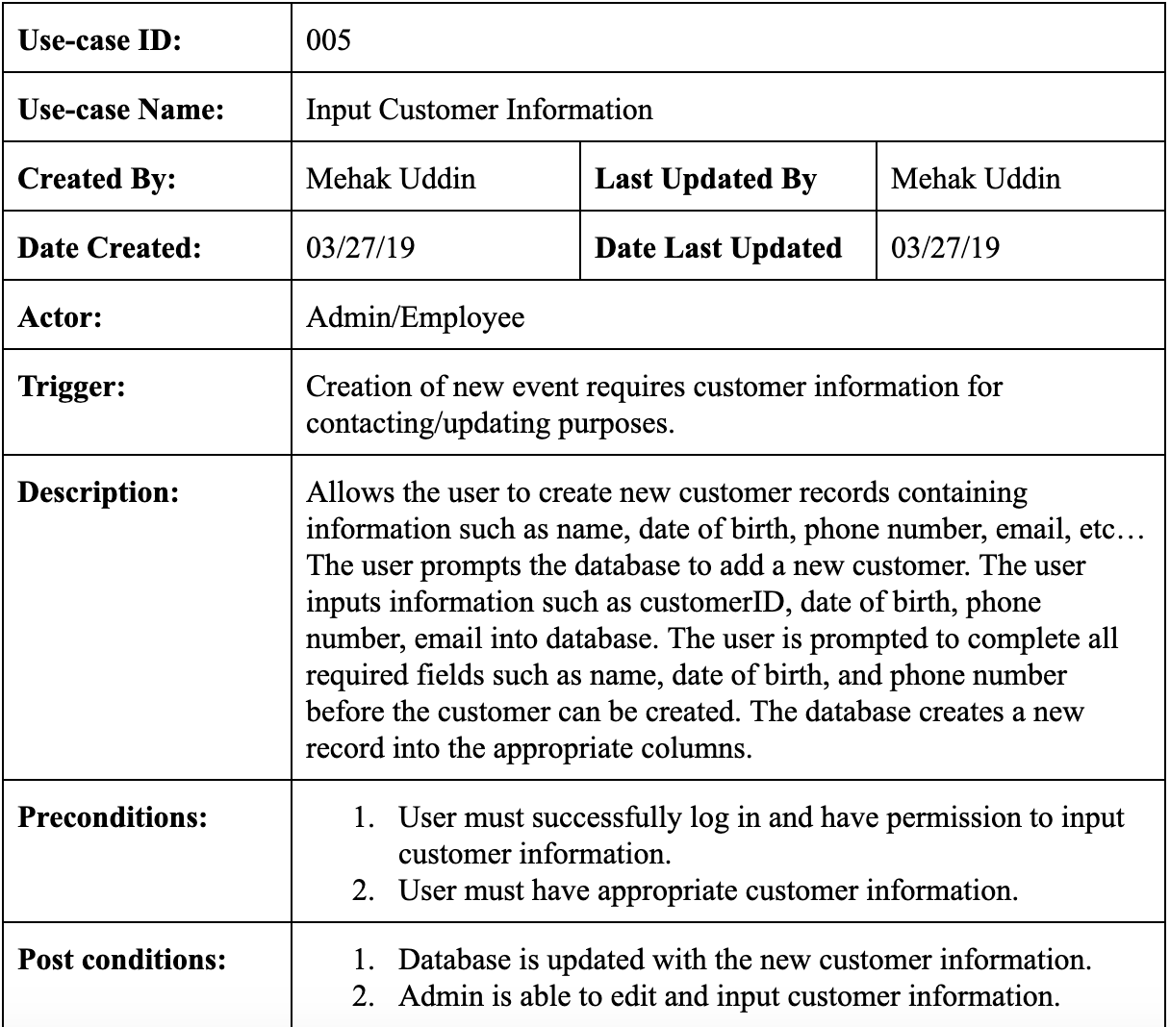
Use Case - Input Customer Information

Slide 13
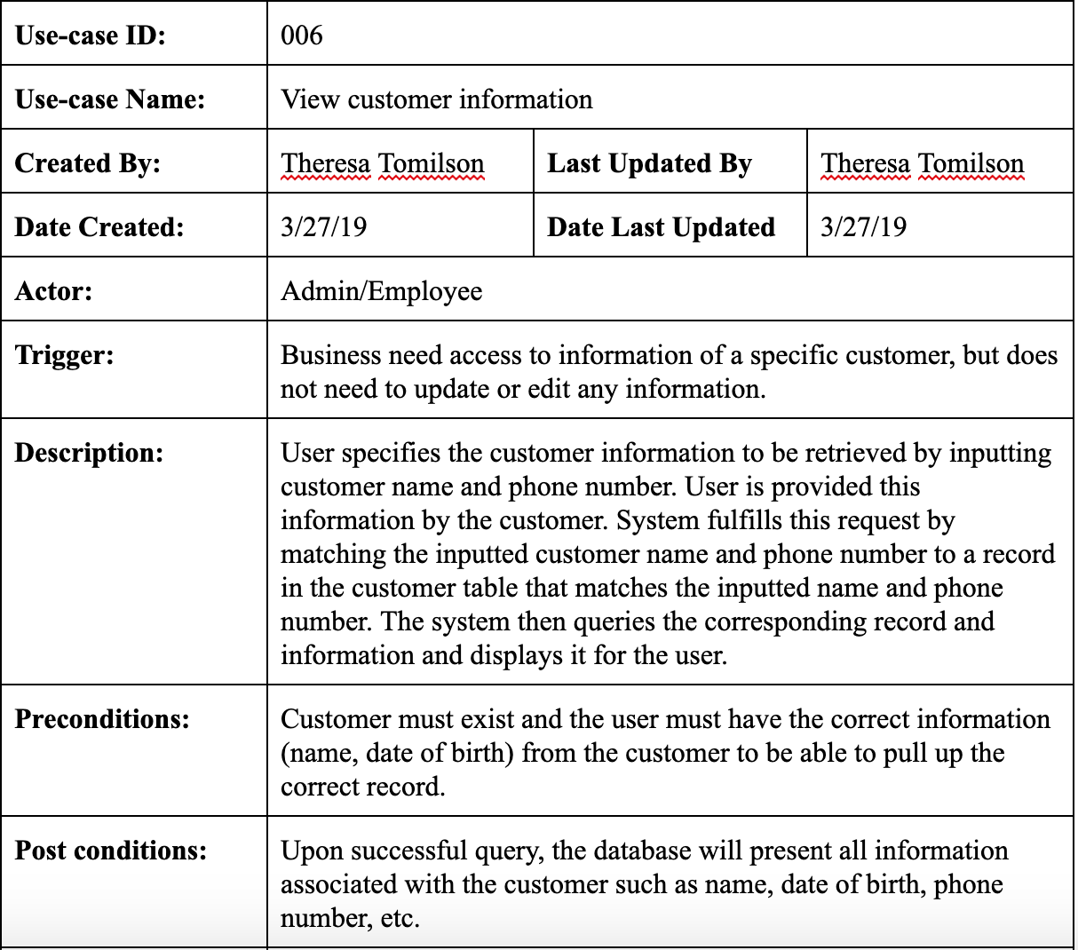
Use Case - View Customer Information

Slide 14
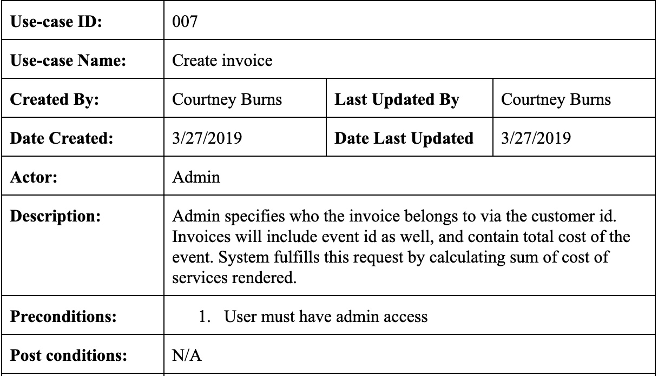
Use Case - Create Invoice

Slide 15
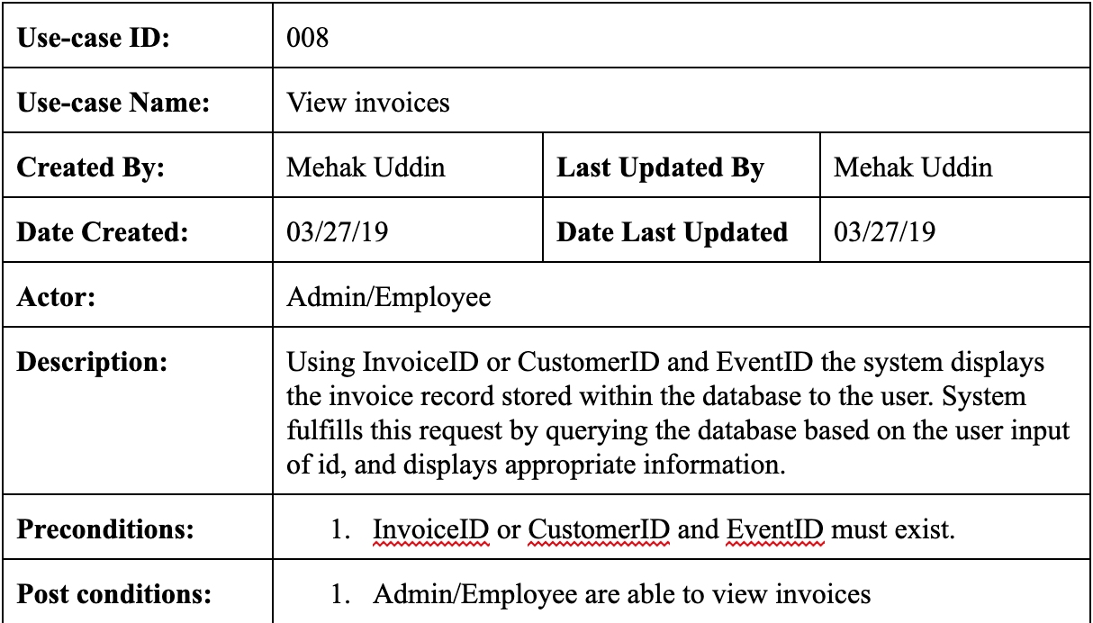
Use Case - View Invoices

Slide 16
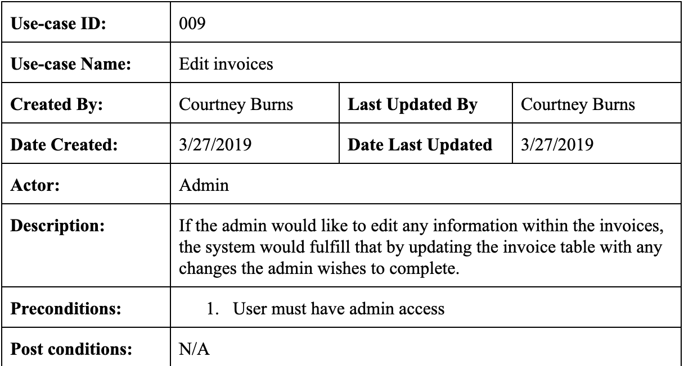
Use Case - Edit Invoices

Slide 17
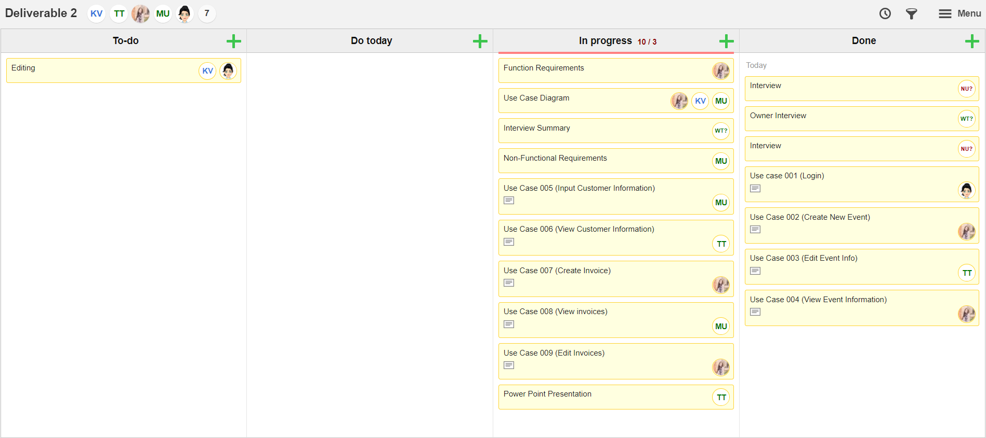
KanbanFlow

Slide 18
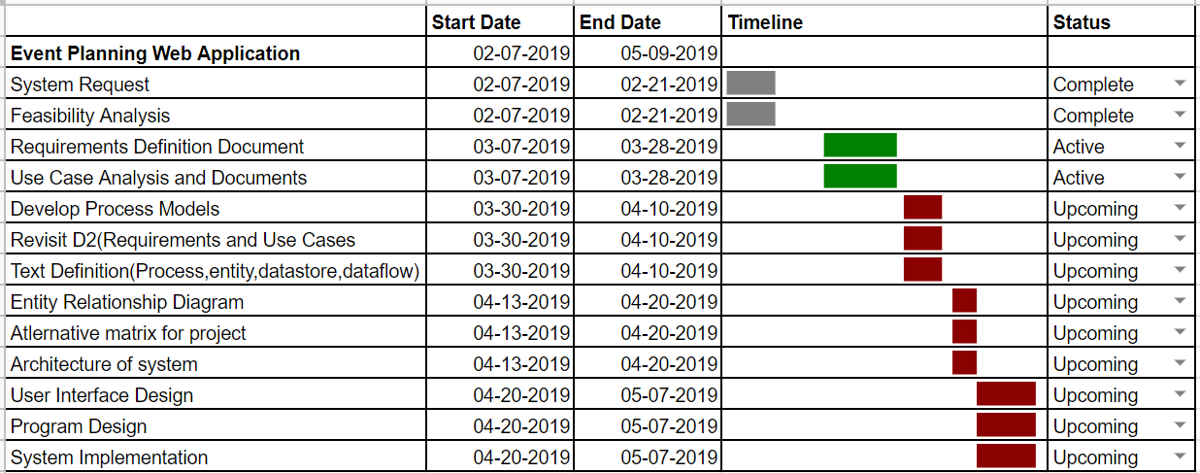
Gantt Chart

Slide 19
Questions? Comments? Concerns?

